Slide 1
California State University, Sacramento Computer Science Department
CSC 179 : Software Testing and Quality Assurance
Summer 2022
Lecture # 3
Software Testing Process & Modeling
Modeling the Software and the Software Environment

Slide 2
Software Testing Process -Four Phases-
1. Modeling the software and the software environment.
2. Designing test cases.
3. Automating, executing, and evaluating test cases.
4. Measuring testing progress.

Slide 3
Modeling The Software
Test engineers need to understand not only the software, but also the environment in which it operates.
Models should be a depiction of the software’s behavior, which can be described in terms of the input sequences accepted by the system; the actions, conditions, and output logic; or the flow of data through the applications, modules, and routines.
Useful models typically possess properties that make test generation effortless and, frequently, automatable.

Slide 4
Modeling Techniques
Decision Tables – Tables used to show sets of conditions and the actions resulting from them
Finite State Machines – A computational model consisting of a finite number of states and transitions between those states, possibly with accompanying actions
State charts – Behavior diagrams specified as part of the Unified Modeling Language (UML). A state chart depicts the states that a system or component can assume and shows the events or circumstances that cause or result from a change from one state to another.

Slide 5
Modeling the Software Developing the Model & Exploring the System
Develops an in-depth understanding of the system's functionality.
This is accomplished by:
Using the application
Thoroughly examining the specification
Develop a model
5

Slide 6
Modeling the Software Understanding The System Under Test
Develop a “Behavioral Model ” – State Transition Diagram –
To understand the system under test ……
Identify all states and inputs
Form a state transition table
Form a state transition diagram
6

Slide 7
Understanding The System Under Test
Each input found is analyzed with two questions
When is the input available?
What happens after the input is applied?
7

Slide 8
Understanding The System Under Test
Light Switch Example –
Description: A simple light switch simulator
The following are the details -
The lights can be turned on and off using one input.
The intensity of the light can be adjusted using two inputs for decreasing and increasing the intensity.
There are three levels of light intensity: dim, normal, and bright. If the lights are bright, increasing the intensity should not affect the intensity.
The simulator starts with the lights off. Finally, when the lights are turned on, the intensity is normal by default, regardless of the intensity of the light when it was last turned off.
8

Slide 9
Understanding The System Under Test
Light Switch Example
“Light Switch” = (I, S, T, F, L), where:
I = {<turn on>, <turn off>, <increase intensity>, <decrease intensity>}
S = {[off], [dim], [normal], [bright]}
T:
<turn on> changes [off] to [normal]
<turn off> changes any of [dim], [normal], or [bright] to [off]
<increase intensity> changes [dim] to [normal], or [normal] to [bright]
<decrease intensity> changes [bright] to [normal], or [normal] to [dim]

Slide 10
Understanding The System Under Test
The inputs do not affect the state of the system under any condition not described above
F = [off]
L = [off]
10

Slide 11
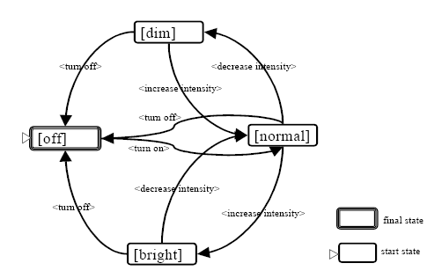
Light Switch Example - State Transition Diagram
11

Slide 12
Light Switch Example - State Transition Matrix
State\ Input | <turn on> | <turn off> | <increase intensity> | <decrease intensity>
[off] | [normal]
[dim] |  | [off] | [normal]
[normal] |  | [off] | [bright] | [dim]
[bright] |  | [off] |  | [normal]
12

Slide 13
Another Example State Transition Diagram - Reservation System
cancel()
[reservedSeats > 1]
reserve()
reserve()
NoReservation
entry/reset()
Partially-
Reserved
[FreeSeats > 1]
cancel()
[reservedSeats = 1]
reserve()
openFlight()
cancelFlight()
cancel()
[FreeSeats = 1]
close()
FullyBooked
Closed
close()

Slide 14
State Transition Diagram – Challenges
State Space Explosion: Number of states can be increased in a dramatical manner.
Solutions:
Abstraction: For example, a dialog box that requires the entry of multiple fields of data followed by the OK button, could be modeled as two abstract inputs: “enter valid data” and “enter invalid data.”
Exclusion: Simply dropping information without bothering to abstract it. This is mostly done when decomposing a set of software behaviors into multiple models.
Each model will contain certain inputs and exclude others. The inputs excluded by a modeler would have to be tested in some other way, obviously.

Slide 15
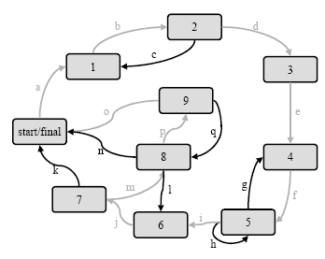
State Transition Diagram – Challenges
Meeting Coverage Criteria
For state machines, coverage is expressed in terms of inputs, states, and transitions.
For example, there is the criterion of covering all states.

Slide 16
Modeling The Software Use Case Model
Why The Use Case Model
Models how different actors interact with the system – simplifies communications and show interactions
Describes the goals of the users, the interactions between the users and the system
Captures the required behavior of the system in satisfying these goals.

Slide 17
Modeling The Software Use Case Model
Serves as a unifying thread throughout system development.
Used as the primary specification of the functional requirements for the system
Serves as the basis for analysis and design, as an input to iteration planning, as the basis of defining test cases
Captures the dynamic behavior of the system

Slide 18
Example BANKING APPLICATION
USE CASE Modeling
18

Slide 19
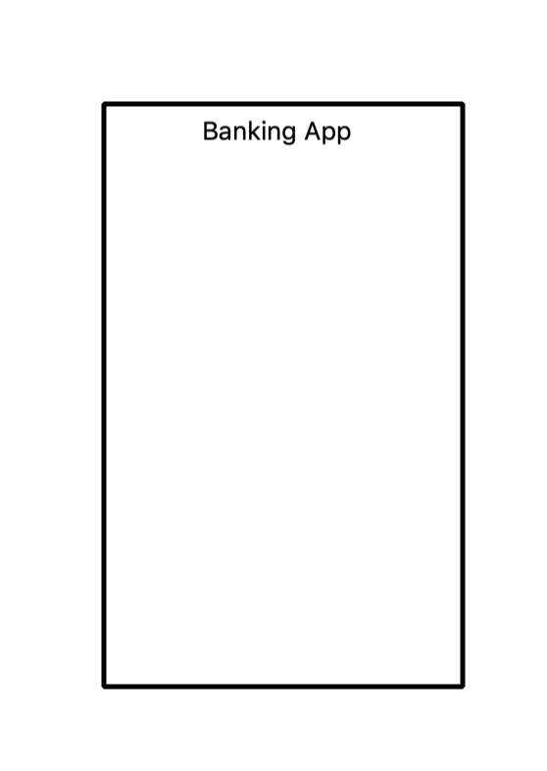
Identify the System
System = Banking App.
A system is represented by a rectangular box as below:
It helps to find scope of the system
Defines system boundaries
19

Slide 20
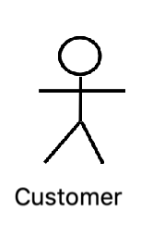
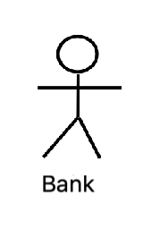
Identify Actors
A banking app is used by Customers, the Bank and other vendors
Actors are external so they are placed outside the System
Actors have generic name - Customer, Bank, etc.
Primary Actor = Customer ( initiates the actions)
Secondary Actor = Bank ( responds to actions)
20

Slide 21
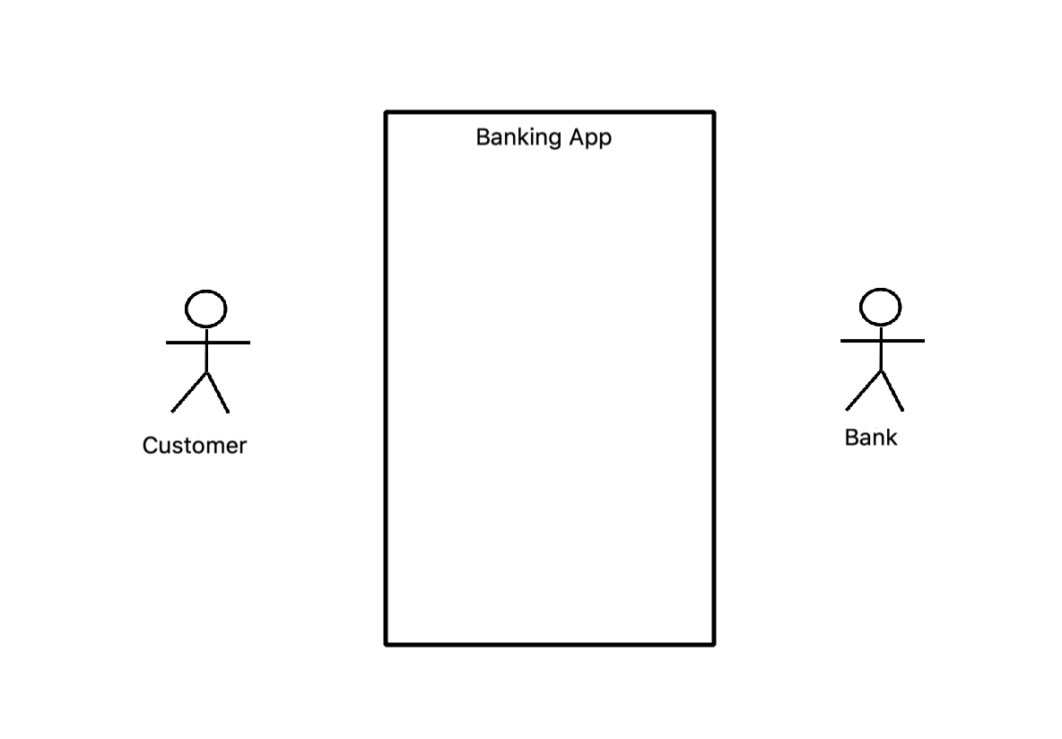
Place Actors
Primary actors are placed on the left of the System
Secondary actors are placed on the right of the System
21

Slide 22
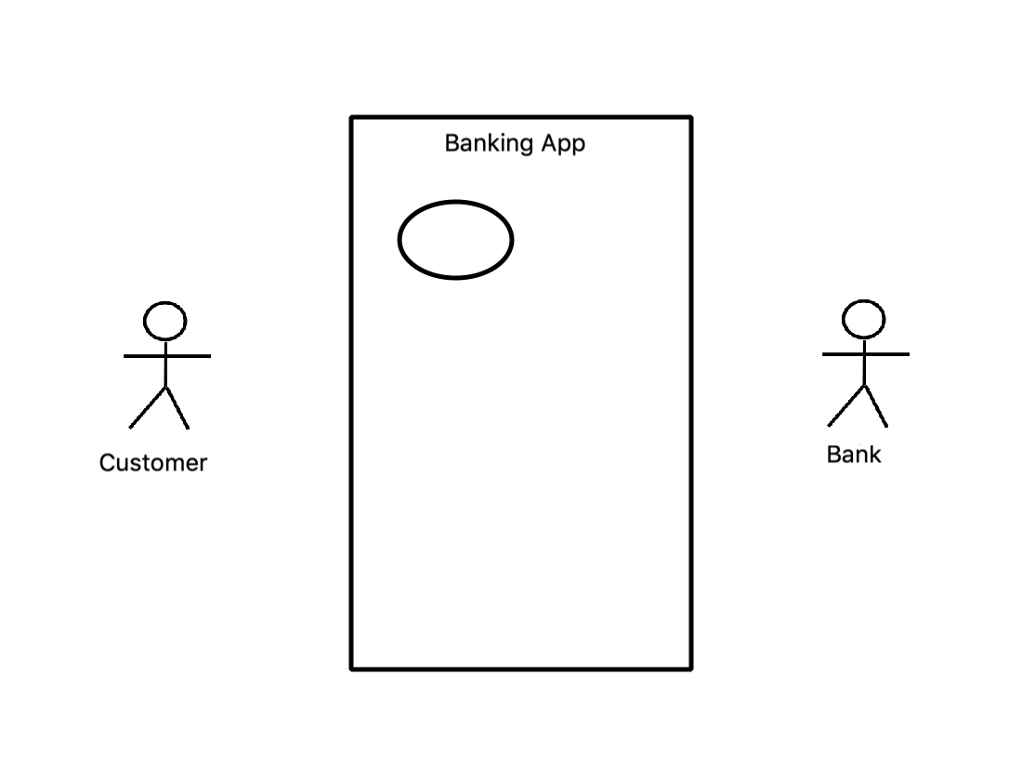
Use case
Use Case represents action that accomplishes actions or task in system.
22

Slide 23
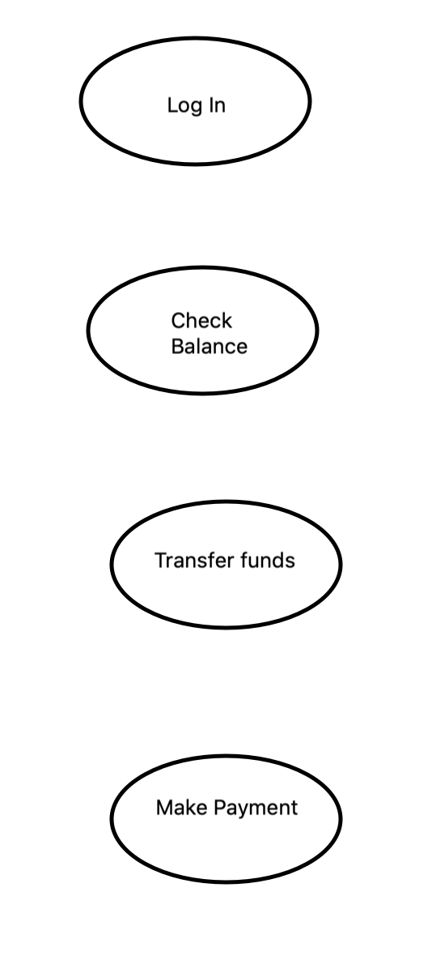
Identify Use cases
For banking app, the actions taken are Log In, checking balance, transferring funds and making payment.
Give descriptive name
Place in logical sequence
Represent these use cases as follows:
23

Slide 24
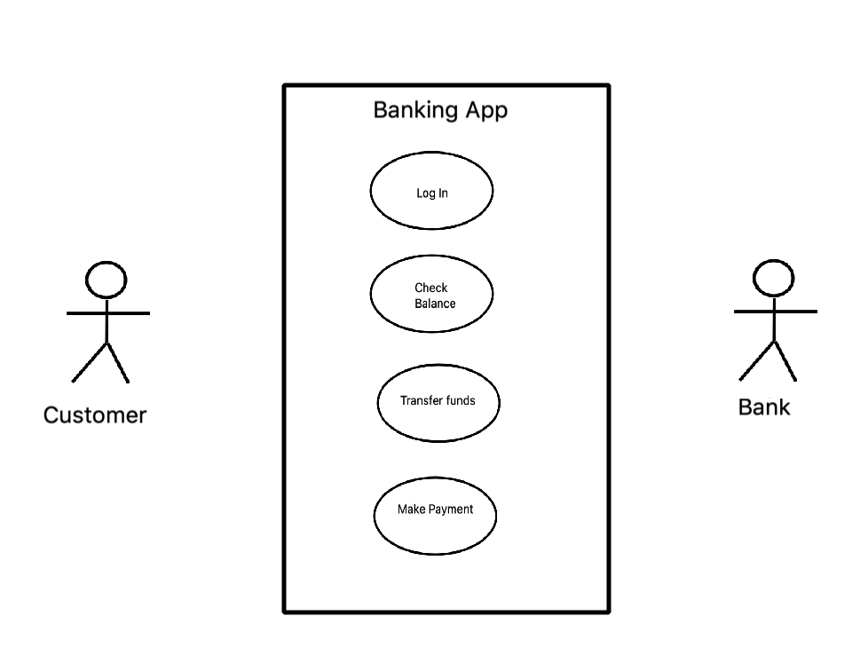
Include use cases in the System
Use cases occur within the System. Place the use cases inside the System
24

Slide 25
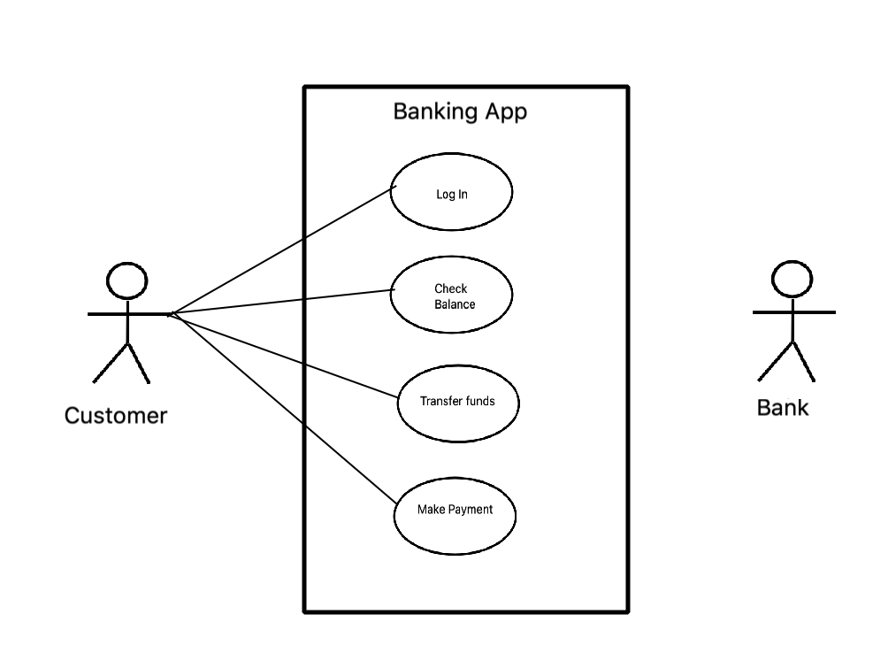
Establish Relationships- Primary Actor
Indicates communication and interactions of the Primary Actor with the System
Draw lines to indicate interactions
25

Slide 26
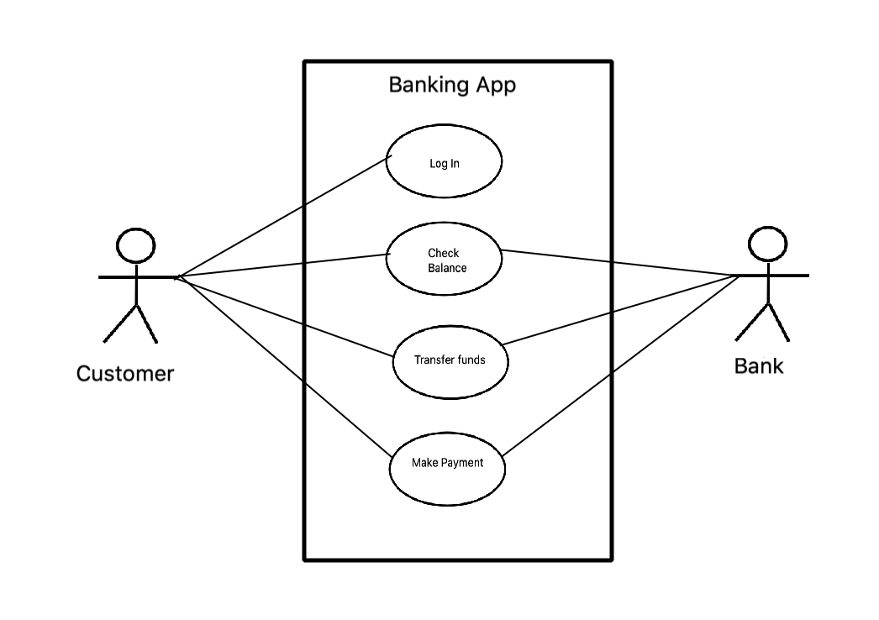
Establish Relationships - Secondary Actor
Indicates communication and interactions of Secondary Actor with the System
Draw lines to indicate interactions
Bank is not involved during Log In so no relationship with that use case
26

Slide 27
Include Extend Relationship
Some use cases extend the functionality of the base use cases and are depicted by Include/Extend relationship
27

Slide 28
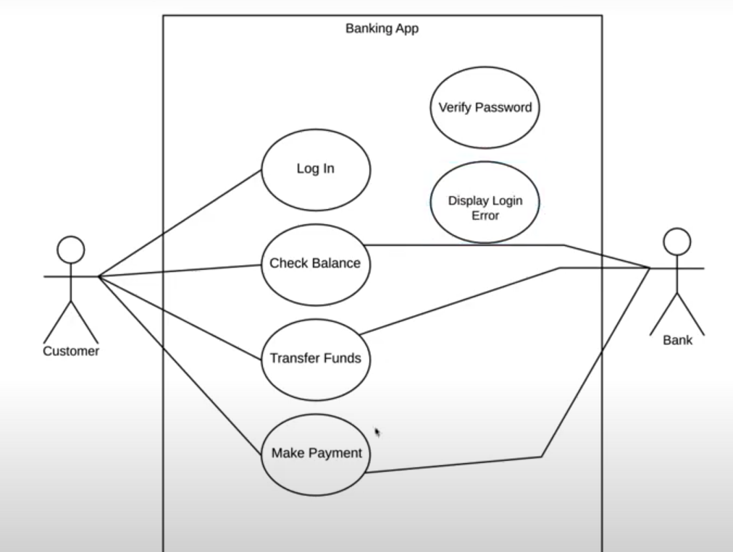
Include & Extend Relationships
Some use cases will have dependent actions.
Example:
1) After login we need to verify password
2) Unsuccessful login can result in Login Error.
28

Slide 29
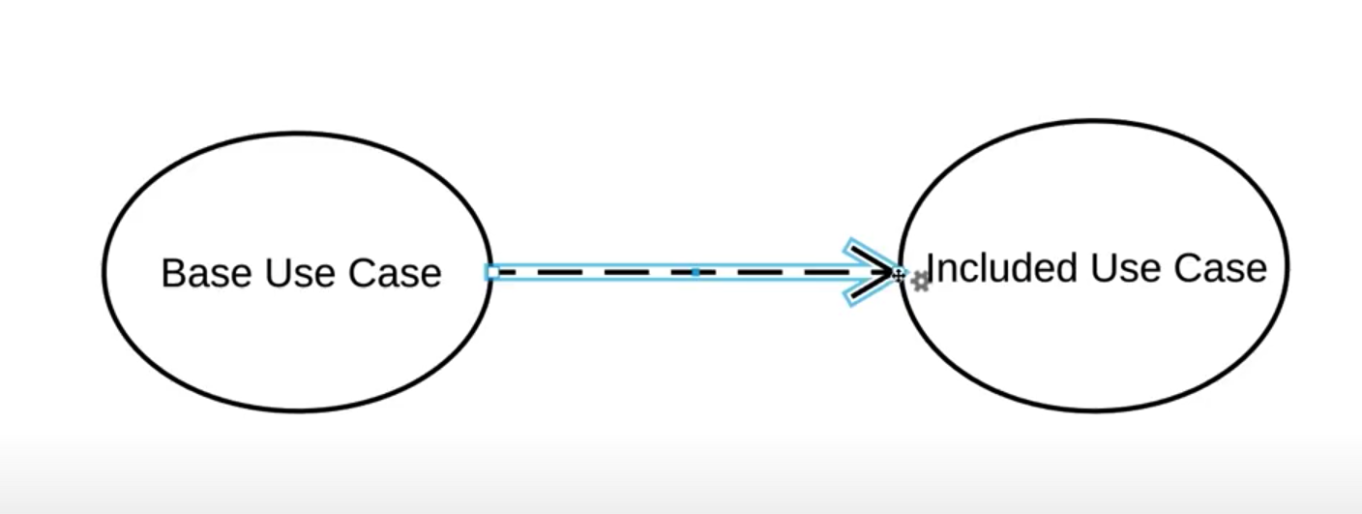
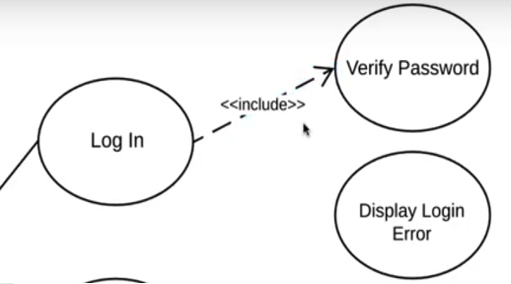
Include Relationships
Include Relationship:
After login we need to verify password
It is an action that must follow login, so it is an Include Relationship
Include is represented as follows
An Included Use Case must follow the Base Use Case
Base Use case not completed until Included use case has been completed
29

Slide 30
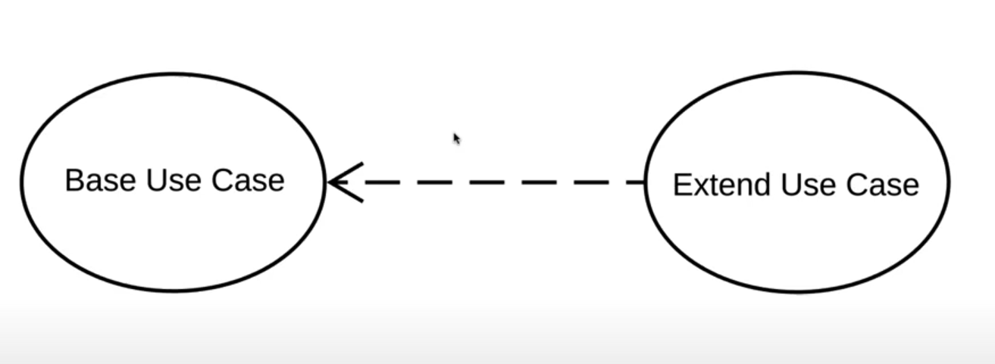
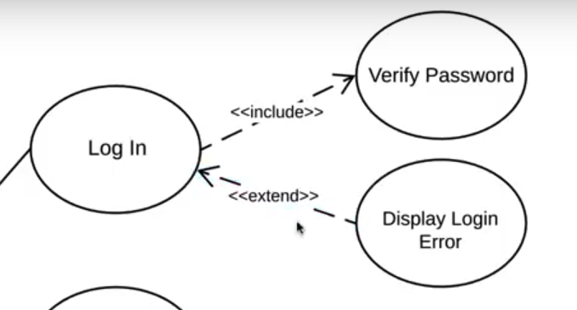
Exclude Relationships
Exclude Relationship
After login, due to incorrect credentials, an error page may be shown
It is an action that may follow login, so it is an Exclude Relationship
Exclude is represented as follows
An Excluded Use Case may happen due to some precondition following the Base Use Case
Base Use case not completed until Included use case has been completed
30

Slide 31
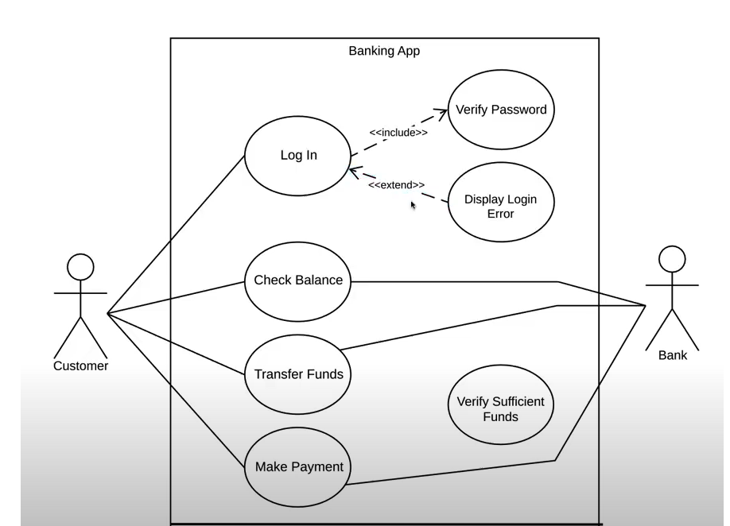
Use Case Diagram – Banking Application
31

Slide 32
Use Case – Another Example

Slide 33
Use Case Relationships
Supply
Order
Customer Data
Product
Arrange
Payment
«include»
«include»
«include»
«extend»
the salesperson asks for
Place
Order
the catalog
Request
Catalog

Slide 34
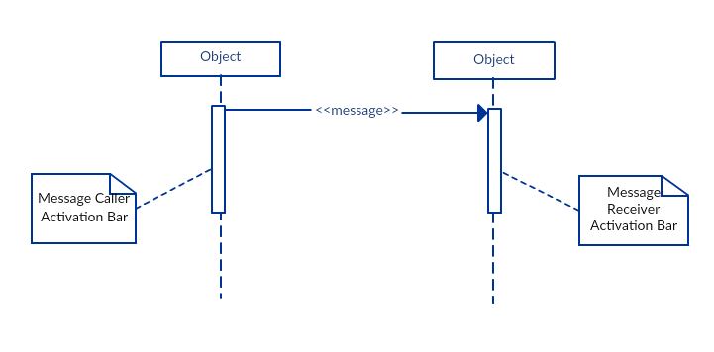
Sequence Diagrams
Sequence diagram is a type of interaction diagrams.
A sequence diagram emphasizes the time-ordering of messages;
34

Slide 35
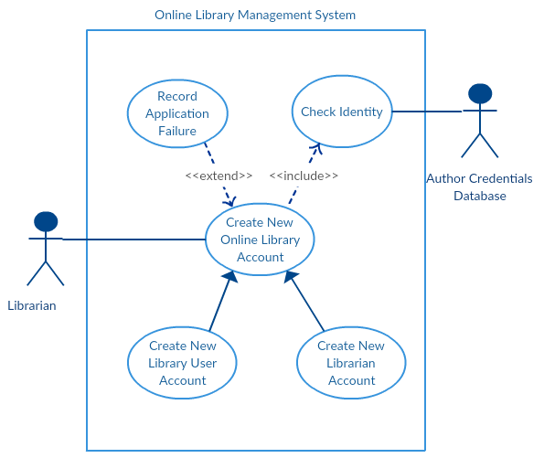
Use Case Model & Sequence Diagram

Slide 36
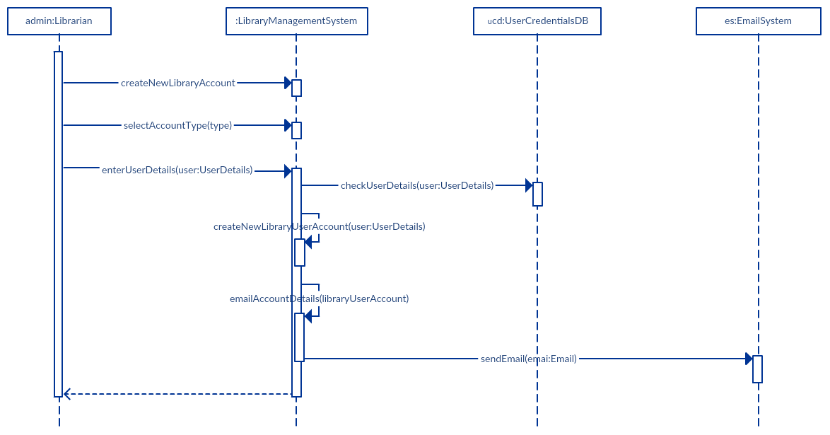
The sequence diagram to perform ‘Create New Library User Account’

Slide 37
Questions..?
37

